Slide 1
Parallel Programming using
Resilient Distributed Datasets

Slide 2
Objectives
•Define Resilient Distributed Datasets (RDDs)
•Define Parallel Programming
•Explain Resilience in Apache Spark
•Relate RDD and Parallel Programming with Apache Spark

Slide 3
What are RDDs
A resilient distributed dataset is:
•Spark's primary data abstraction
•A fault-tolerant collection of elements
•Partitioned across the nades of the cluster
•Capable of accepting parallel operations

Slide 4
Spark applications
Consist of a driver program that runs The user's main functions
And multiple paraLLeL operations
on a cluster.
• ••

Slide 5
RDD supported files
Supported File types
Text
SequenceFiles
Avro
Parquet
Hadoop input formats
Supported File formats
Local
Cassandra
HBase
HDFS
Amazon S3
and others
SQL and NoSQL

Slide 6
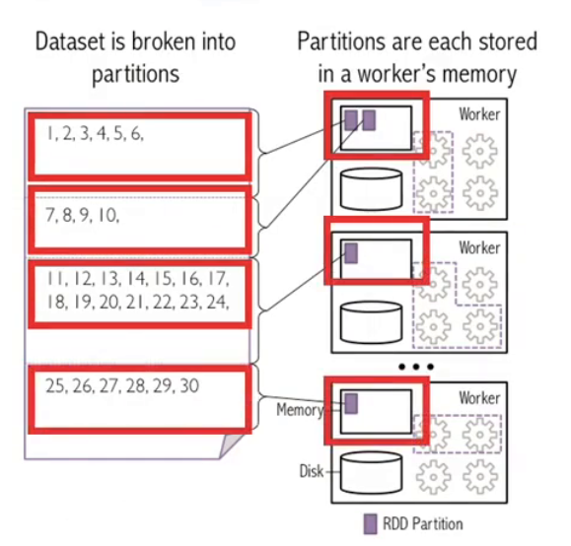
Creating an RDD in Spark
Use an external or local file from Hadoop-supported file system such as:

Slide 7
Create an RDD from a collection
Simple examples of creating a ROO from a list in Scala and Python
// Scala example
val data= Array(l, 2, 3, 4,
5)
val distData = sc.parallelize(data)
// Python example data= [1, 2, 3, 4, 5]
distData = sc.parallelize(data)

Slide 8
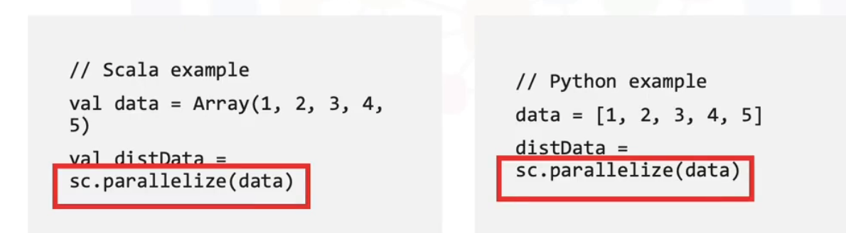
Create an RDD from a collection
Simple examples of creating a RDD from a list in Scala and Python

Slide 9
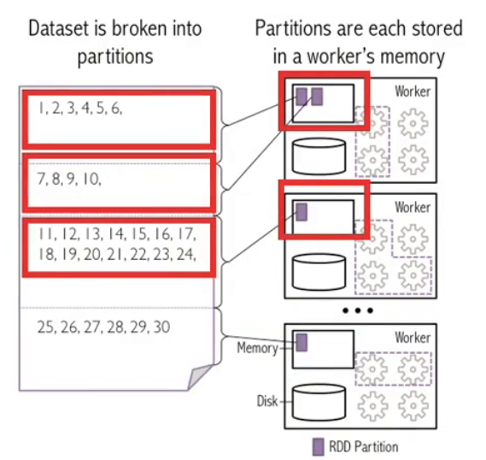
Creating an
RDD in Spark
Apply a
transformation on an
existing RDD to
create a new RDD

Slide 10
What is Parallel Programming
•Parallel programming:
•Is the simultaneous use of multiple compute resources to solve a computational problem

Slide 11
What is Parallel Programming
•Parallel programming:
•Is the simultaneous use of multiple compute resources to solve a computational problem
•Breaks problems into discrete parts that can be solved concurrently
•Runs simultaneous instructions on multiple processors

Slide 12
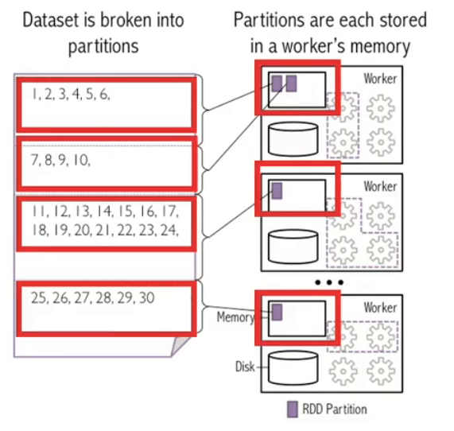
RDDs & Parallel Programming
•Vou can create an RDD by parallelizing an array of objects, or by splitting a dataset into partitions
Spark runs one task for
each partition of the
cluster

Slide 13
Summary
In this video, you learned that:
•Vou can create an RDD using an externa! or local file from Hadoop-supported file, from a collection or from another RDD
•RDDs are immutable and always recoverable
•RDDs can persist or cache datasets in memory across operations, which speeds iterative operations

